Slide 1

Reactive account & microservices
GOAL : BUILDING AND DESIGNING REACTIVE SYSTEMS CALLED REACTIVE ACCOUNT USING DOMAIN DRIVEN DESIGN TECHNIQUE AND PRINCIPLES OF REACTIVE ARCHITECTURE ALONG WITH REACTIVE PROGRAMMING
Project repository : https://github.ibm.com/Tural-Kazimli/Reactive-Account
REFERENCES :
https://akka.io/docs/
https://docs.docker.com/
https://stackoverflow.com/search?q=akka%20actor
https://academy.lightbend.com/
https://cognitiveclass.ai/?s=reactive
https://github.com/akka/akka

Slide 2
WHAT ARE MICROSERVICES ?
Microservices - also known as the microservice architecture - is an architectural style that structures an application as a collection of services that are
Highly maintainable and testable
Loosely coupled
Independently deployable
Organized around business capabilities
Owned by a small team
The microservice architecture enables the rapid, frequent and reliable delivery of large, complex applications. It also enables an organization to evolve its technology stack.

Slide 3
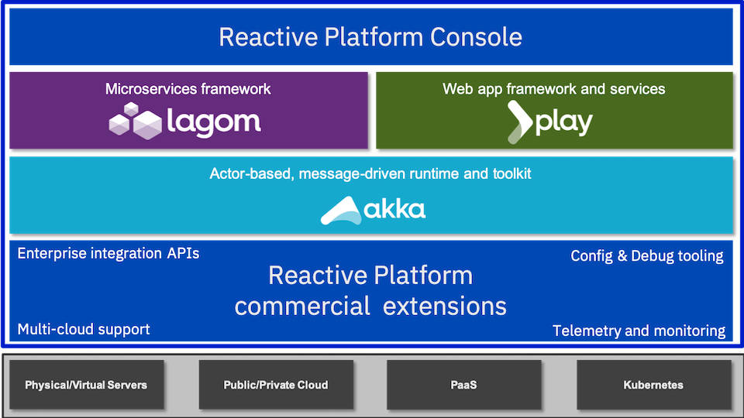
Reactive microservices core tools :

Slide 4


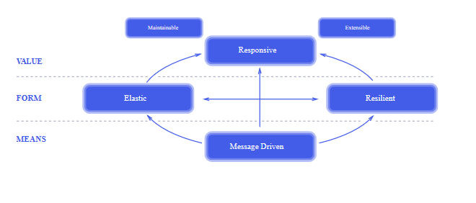
Design techniques and principles :
Domain-Driven Design - Approach to develop software for complex needs by deeply connecting the implementation to an evolving model of the core business concepts
Reactive Principles – Responsive, Elastic, Resilient, Message-Driven
Event Storming - Workshop-based method to quickly find out what is happening in the domain of a software program

Slide 5




LIBRARIES AND TECHNOLOGIES :
JAVA - General-purpose, concurrent, strongly typed, class-based object-oriented programming language
AKKA - Toolkit for building highly concurrent,distributed,resilient,message-driven applications for Java and Scala
MICROSERVICES - Architectural style that structures application as collection of highly maintainable,testable services
DOCKER - Open Source platform for building, deploying, and managing containerized applications.

Slide 6
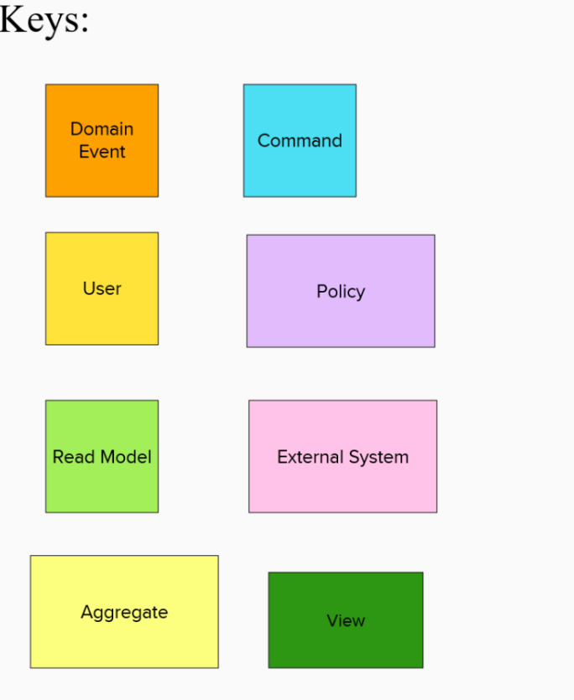
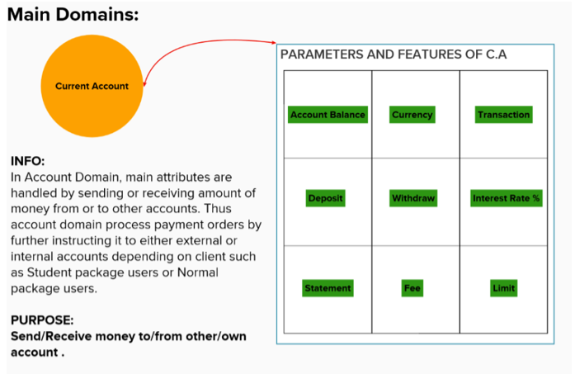
Project architecture and design details :

Slide 7
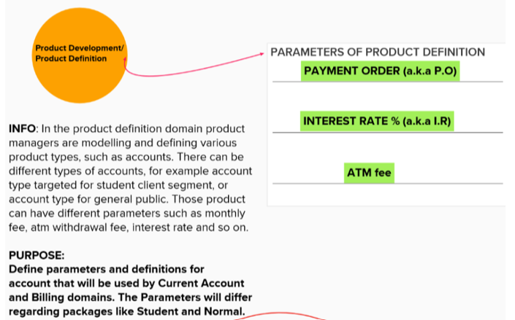
Project architecture and design details :

Slide 8
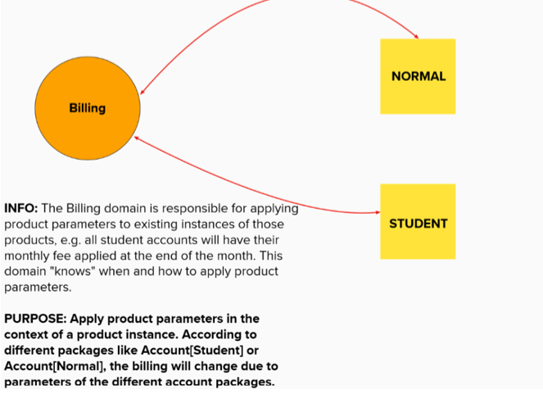
Project architecture and design details :

Slide 9
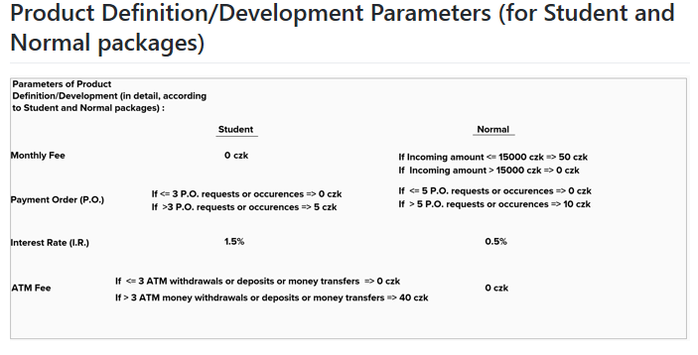
Project architecture and design details :

Slide 10
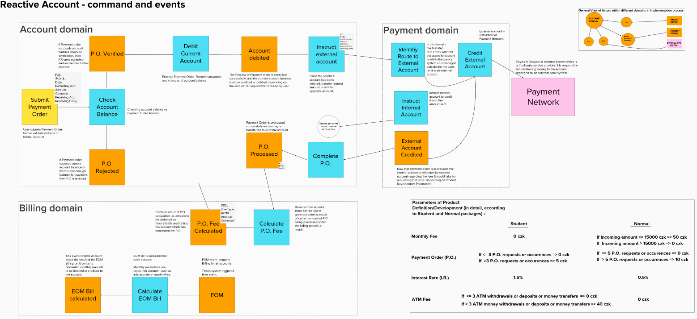
Microservices architecture : main outlook

Slide 11
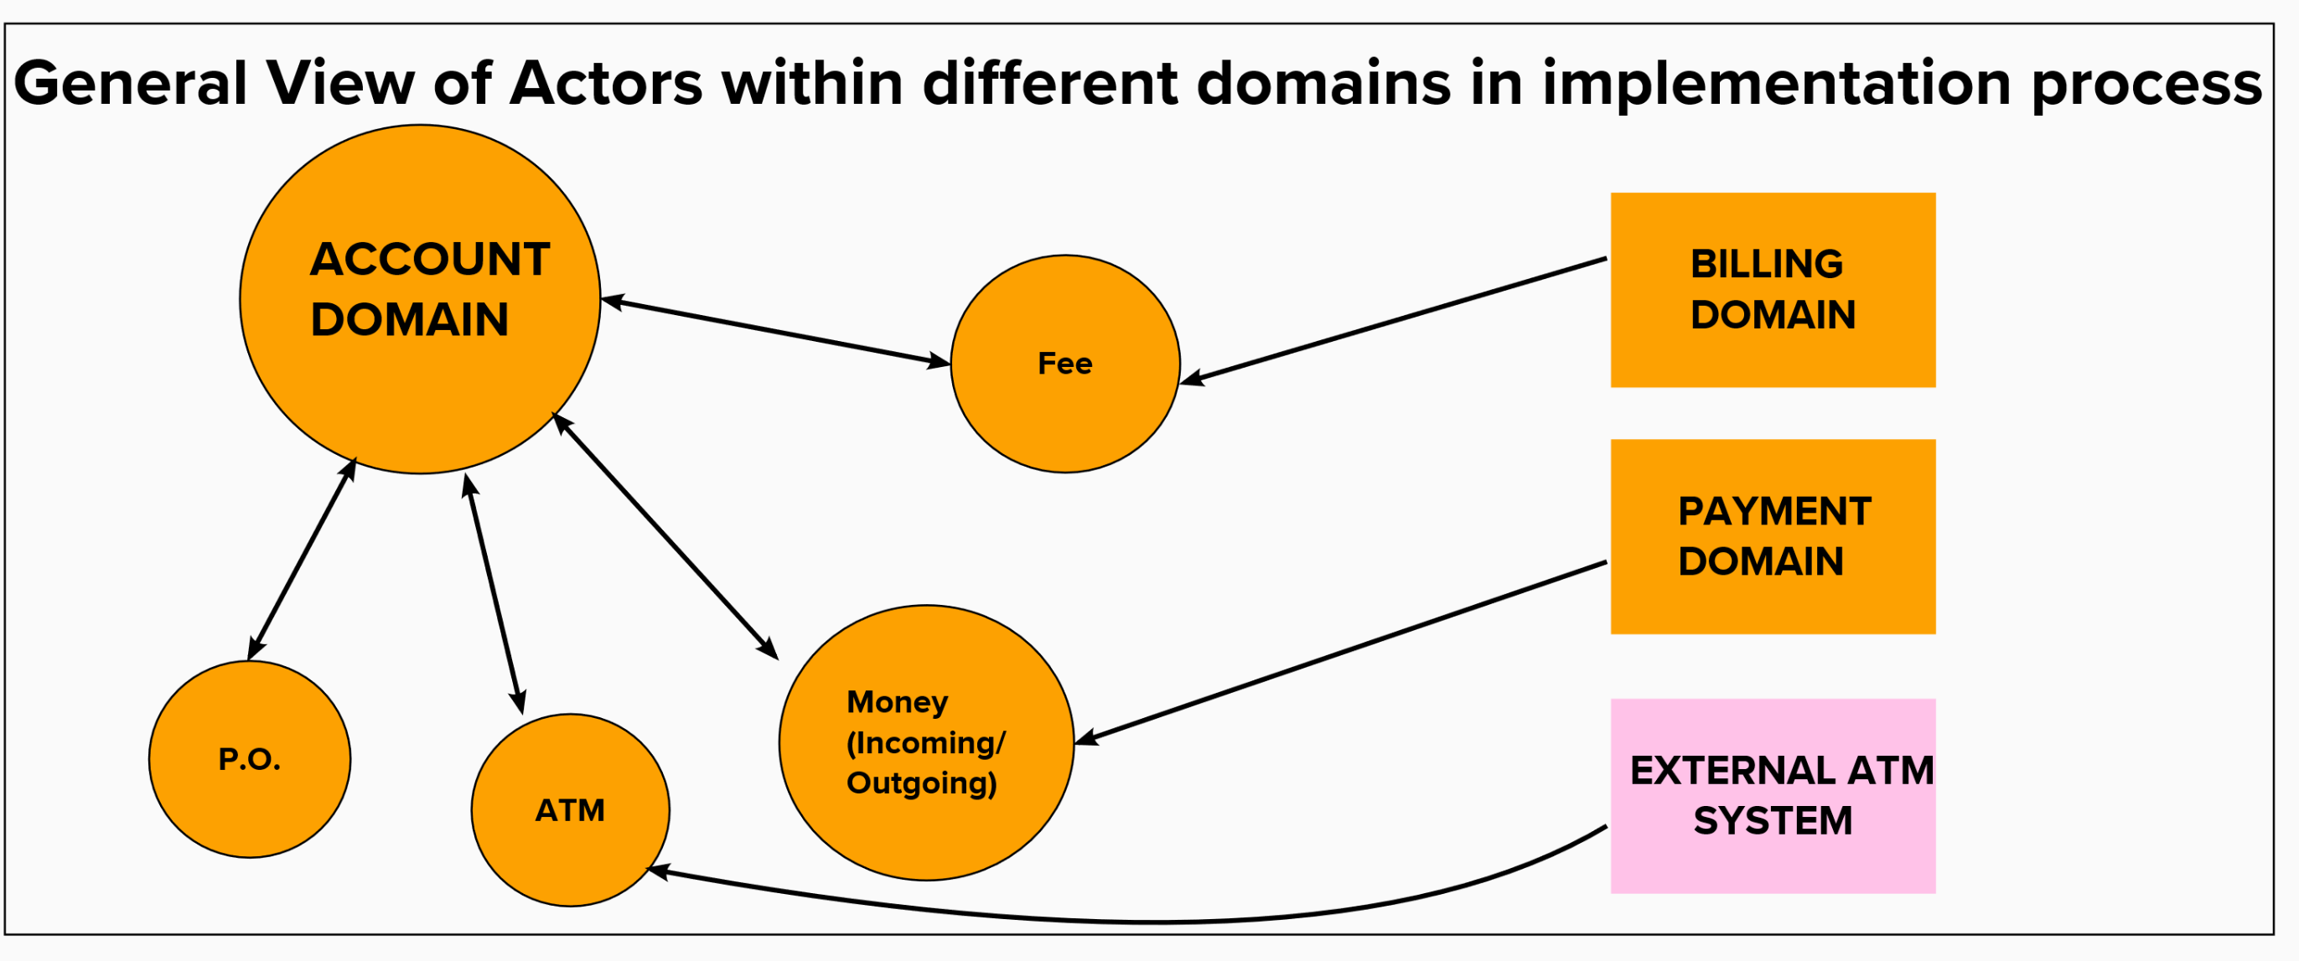
Domains and actors :

Slide 12
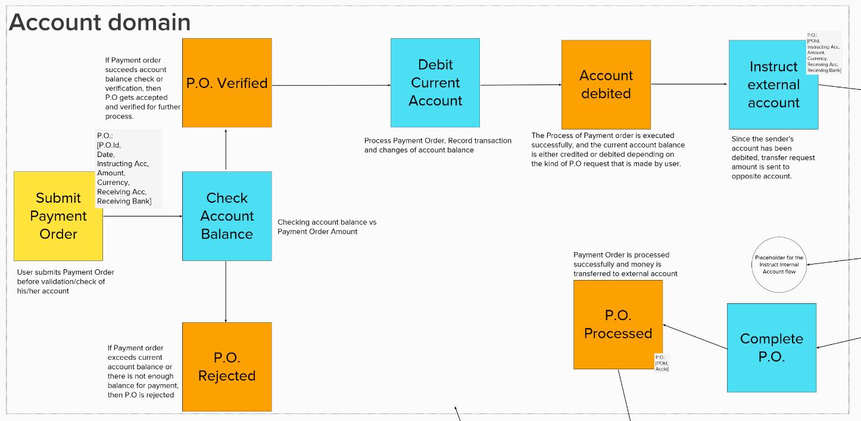
Domains and actors :

Slide 13
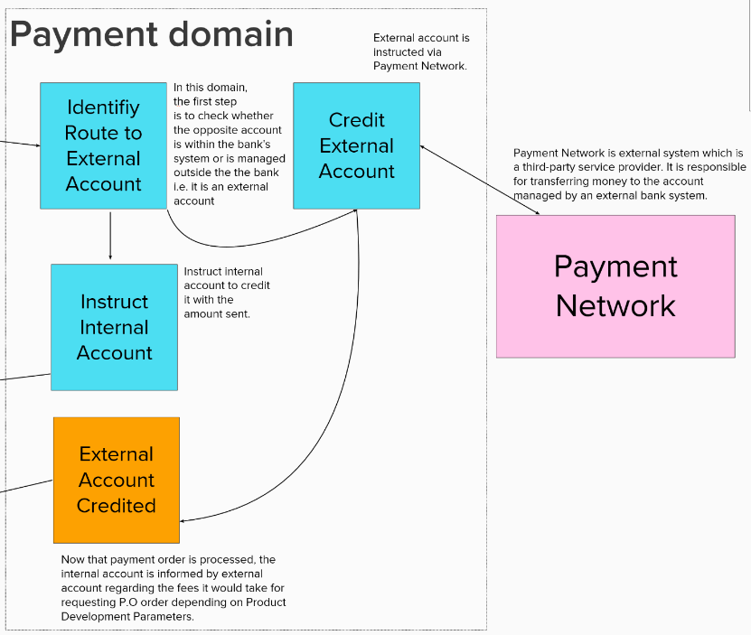
Domains and actors :

Slide 14
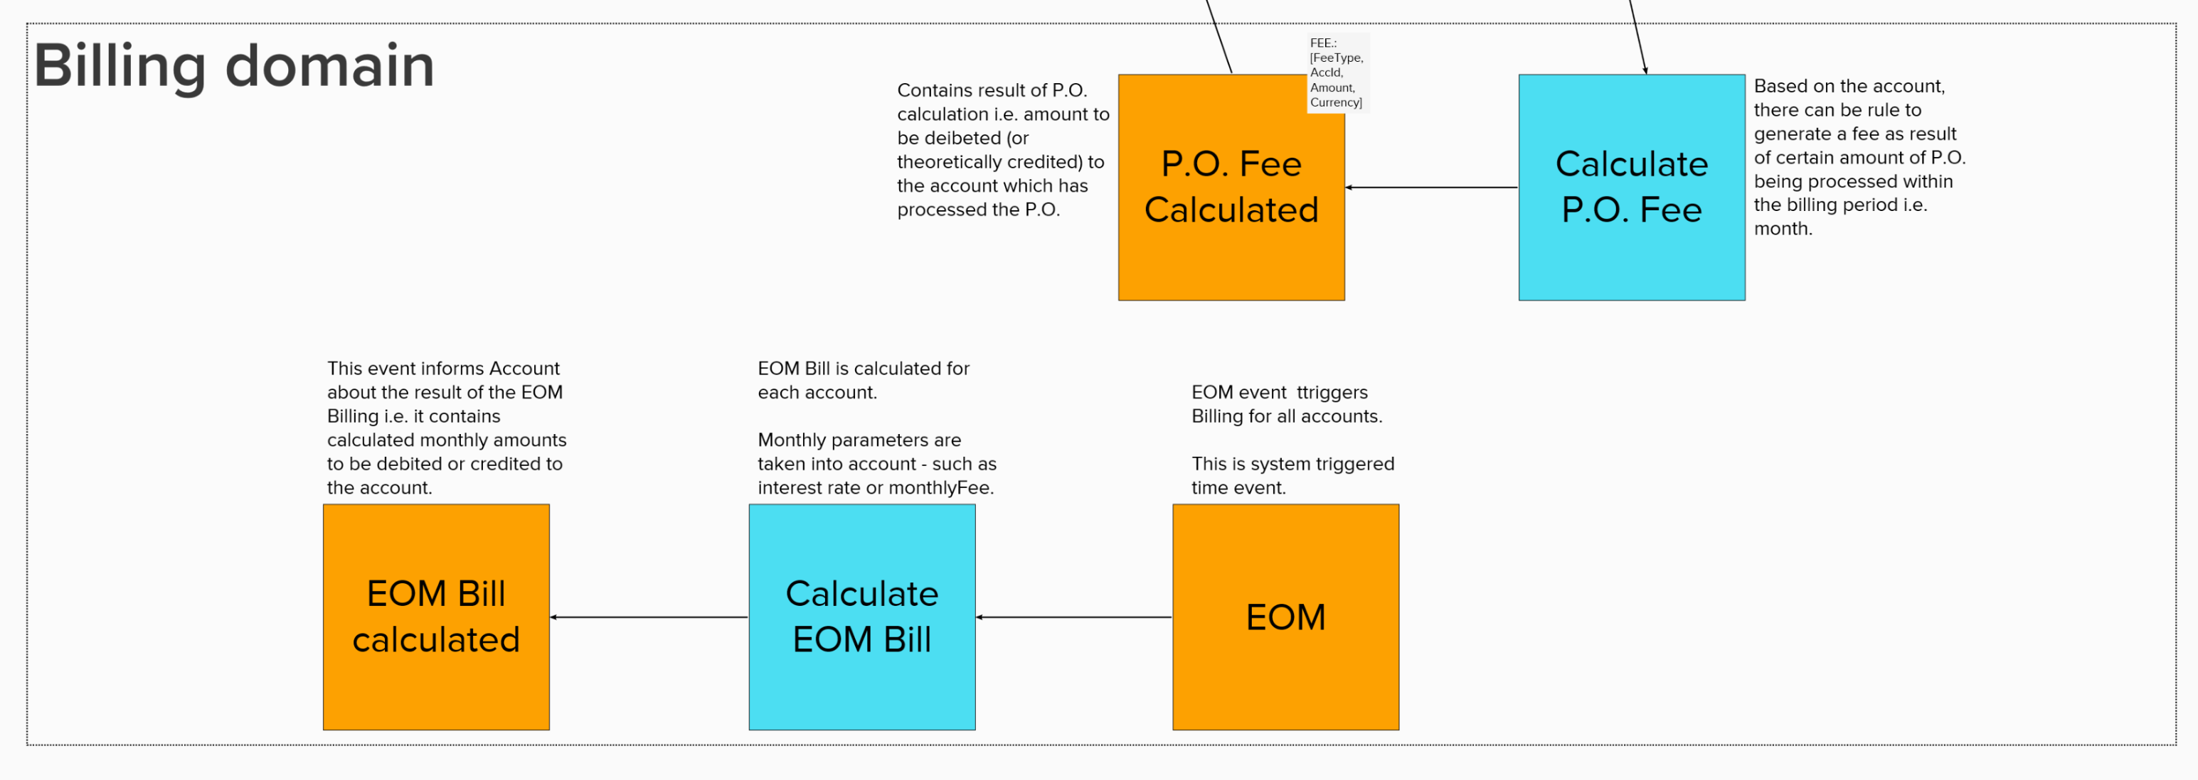
Domains and actors :

Slide 15
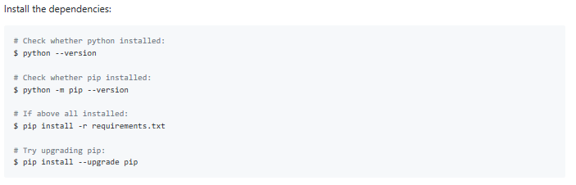
INSTALLATION OF NECESSARY PACKAGES :

Slide 16
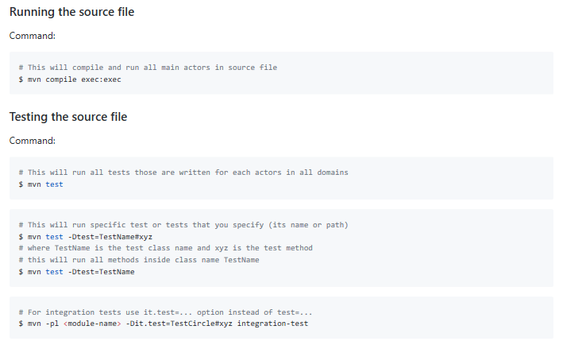
RUNNING AND TESTING THE SOURCE FILE :

Slide 17
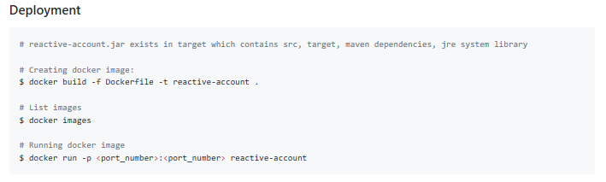
DEPLOYMENT :

Slide 18
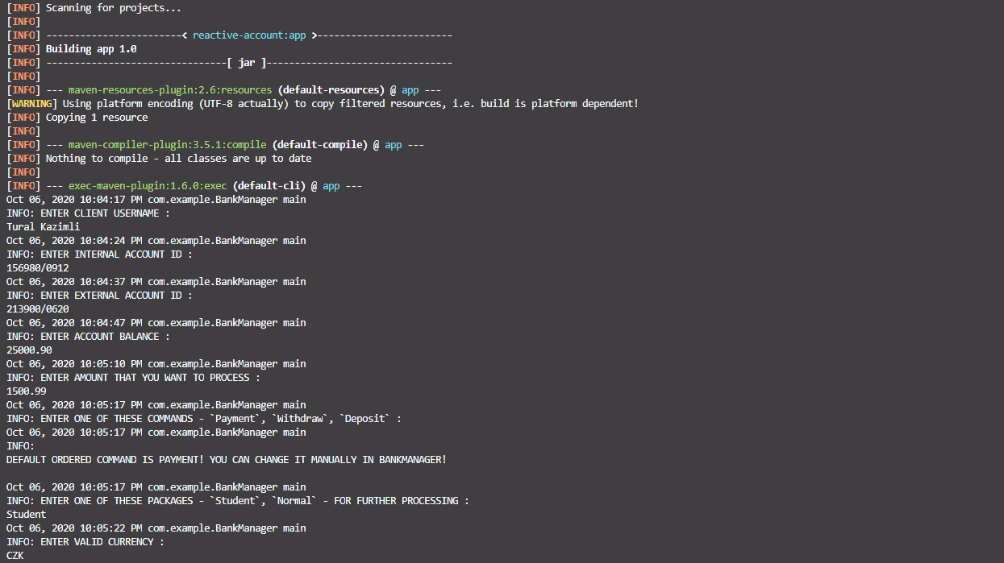
Program execution & compilation :

Slide 19
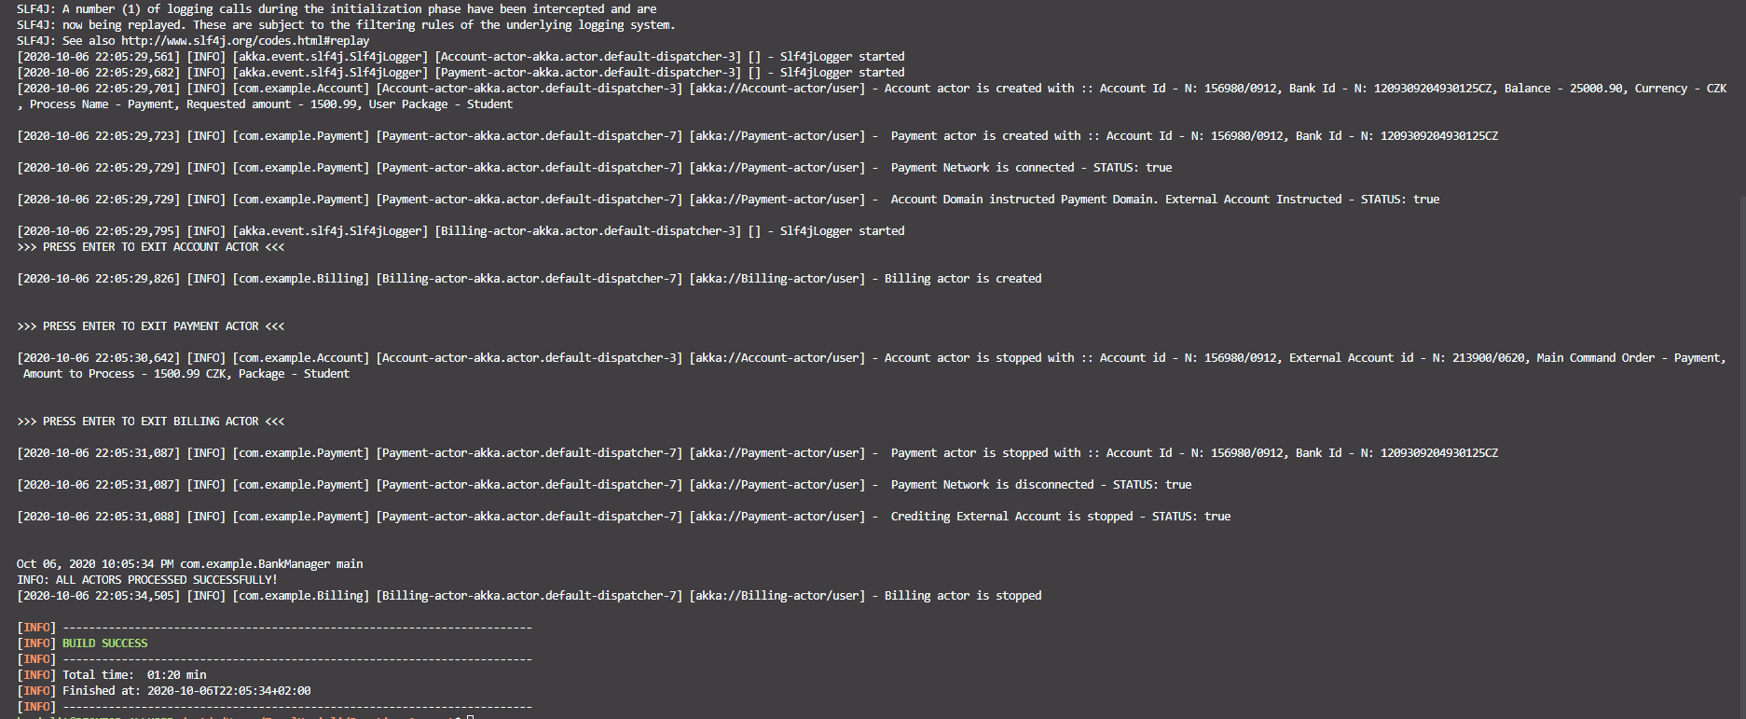
Program execution & compilation :

Slide 20
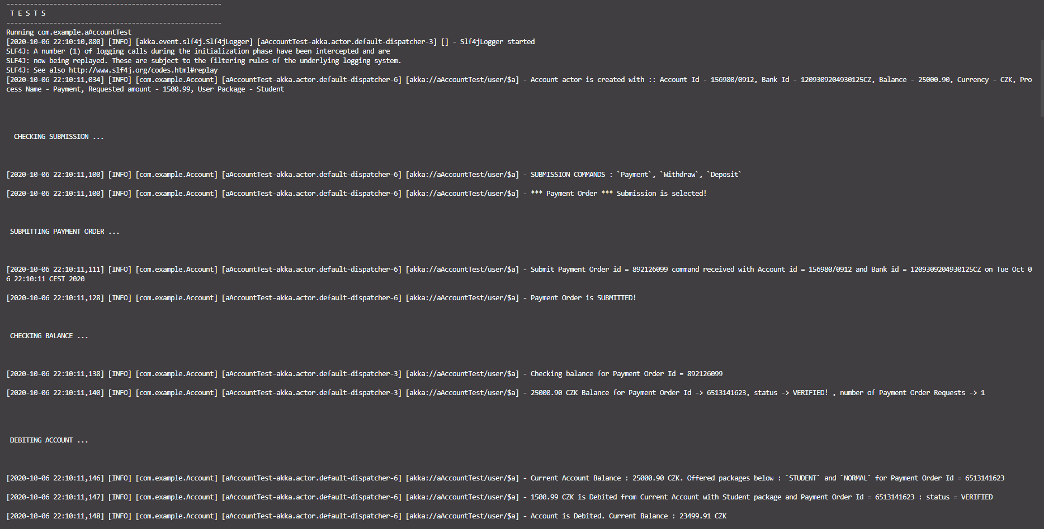
Program testing :

Slide 21
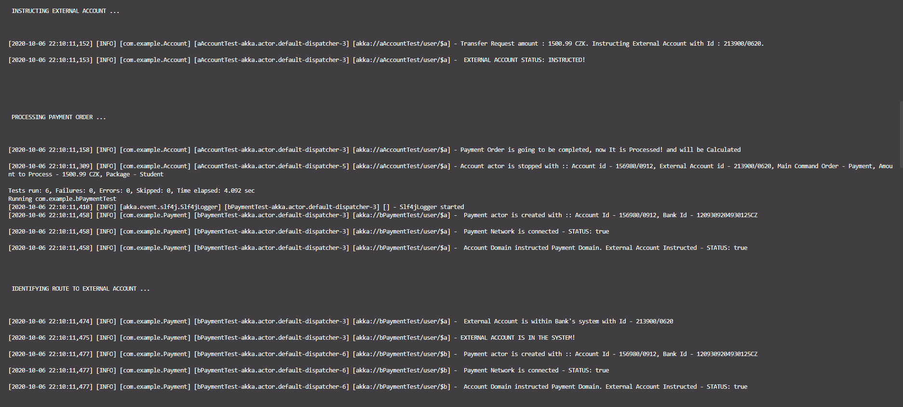
Program testing :

Slide 22
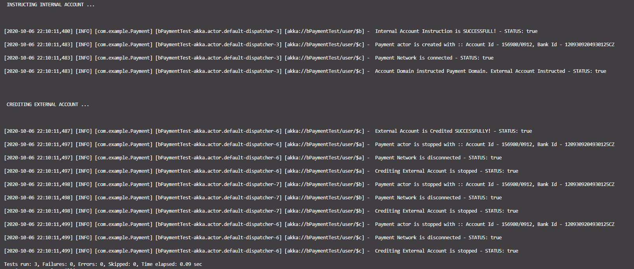
Program testing :

Slide 23
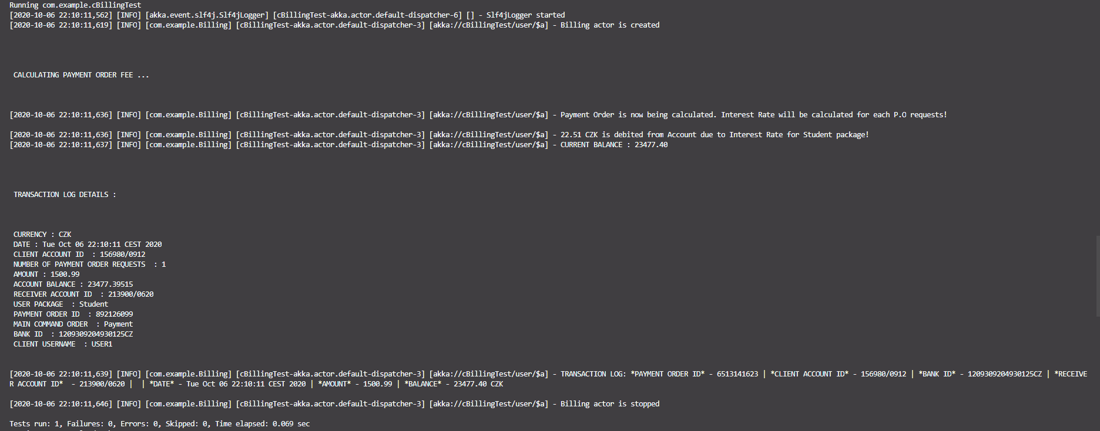
Program testing :

Slide 24
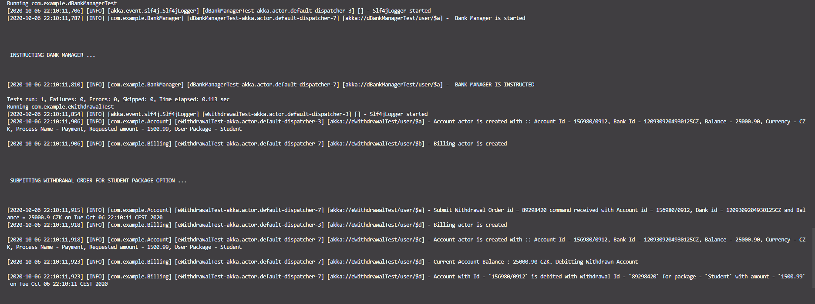
Program testing :

Slide 25
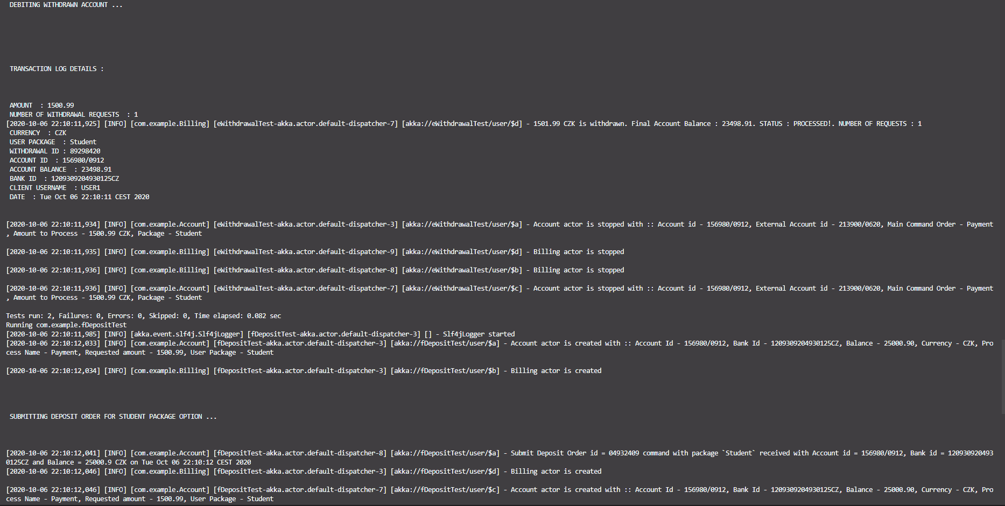
Program testing :

Slide 26
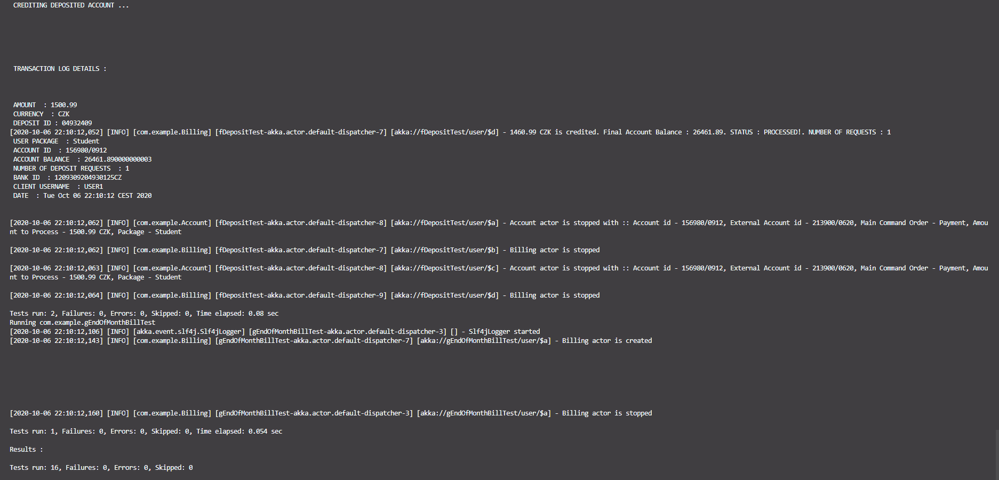
Program testing :

Slide 27
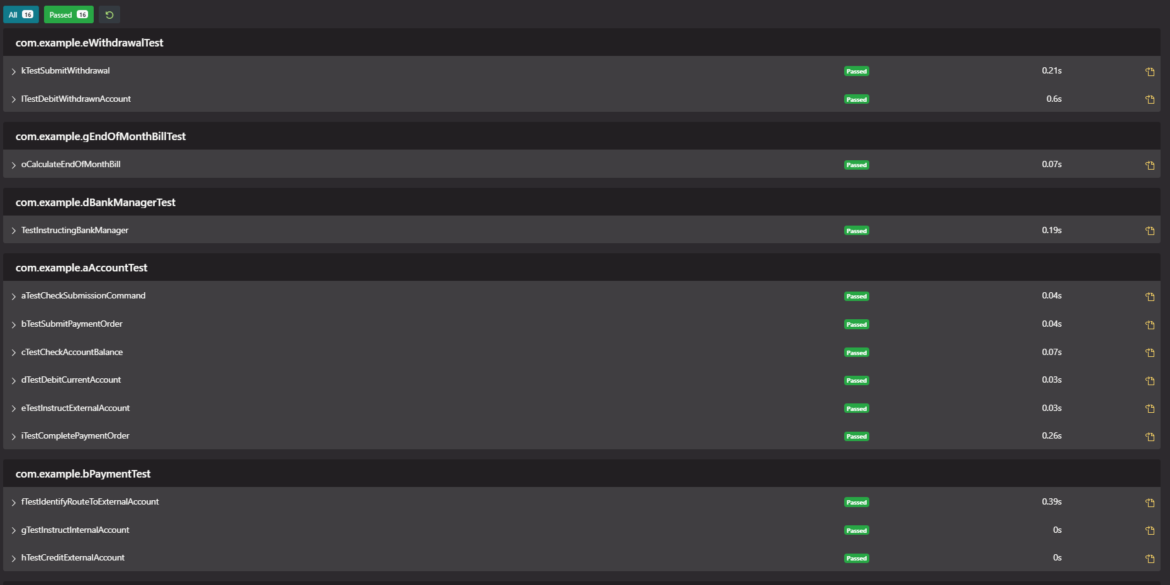
Test report :

Slide 28
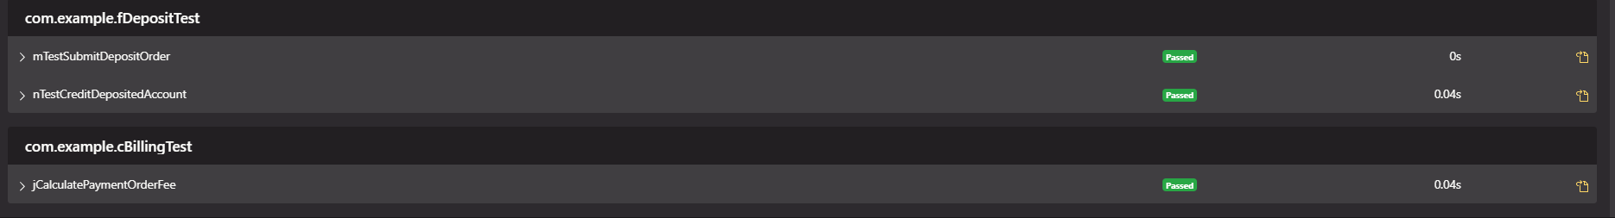
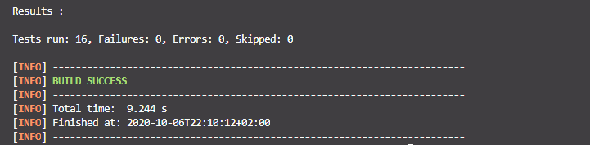
Test report :

Slide 29
Final conclusions
BUILT A REACTIVE MICROSERVICES THAT IMPLEMENTS REACTIVE-PRINCIPLES WITH DOMAIN DRIVEN DESIGN TECHNIQUE
DESIGNED AND DEVELOPED IMPLEMENTATION OF THE REACTIVE ACCOUNT TRANSACTION PROCESSING USING MICROSERVICES ARCHITECTURAL APPROACH AND TECHNOLOGIES
CREATED PRODUCT BACKLOG
APPLIED AKKA ACTOR FRAMEWORK ALONG WITH MICROSERVICES IMPLEMENTATION AND TESTING IN JAVA, LASTLY DEPLOYED APPLICATION USING DOCKER
ADDED EXTRA FEATURES SUCH AS TRANSACTION LOG, ACTOR CYCLE MOVEMENTS, TESTING BEHAVIOR FOR INTEGRATION TESTING AND INTERACTIVELY ADDED AND SOLVED ISSUES IN GITHUB

Slide 30
THANK YOU FOR YOUR ATTENTION!

